Slide 1
Technology in the
Adult ELL Classroom

Slide 2
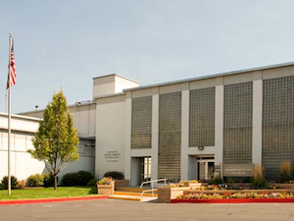
Humanitarian Center English Program
Jennifer Christenson, Coordinator jchristenson@granitesd.org
Maddie Townsend, Beginning ELL teacher maddie.townsend.412@gmail.com
Sergei Prutski, Intermediate ELL teacher sprutskyi@graniteschools.org

Slide 3
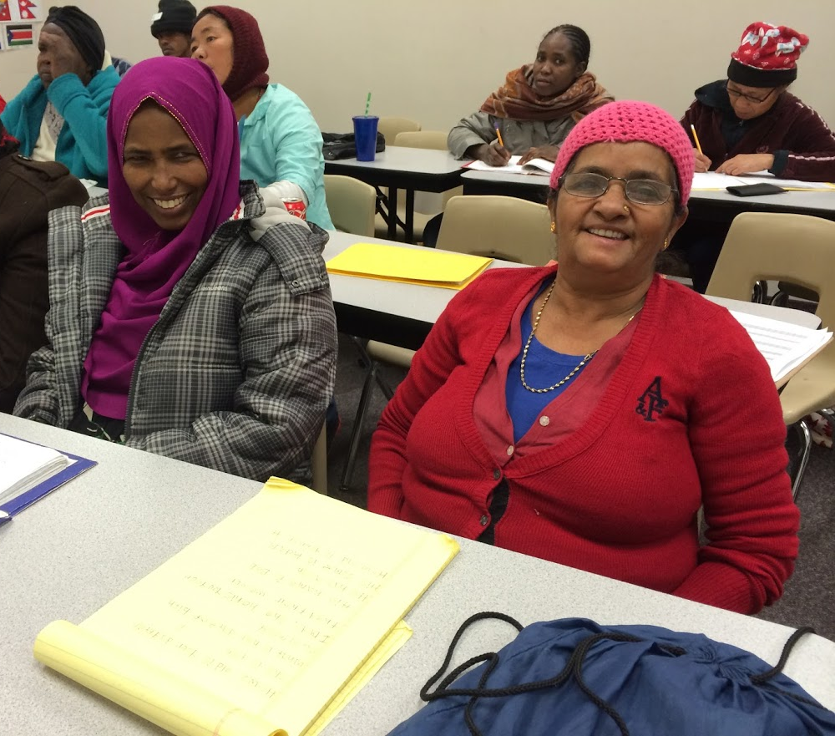
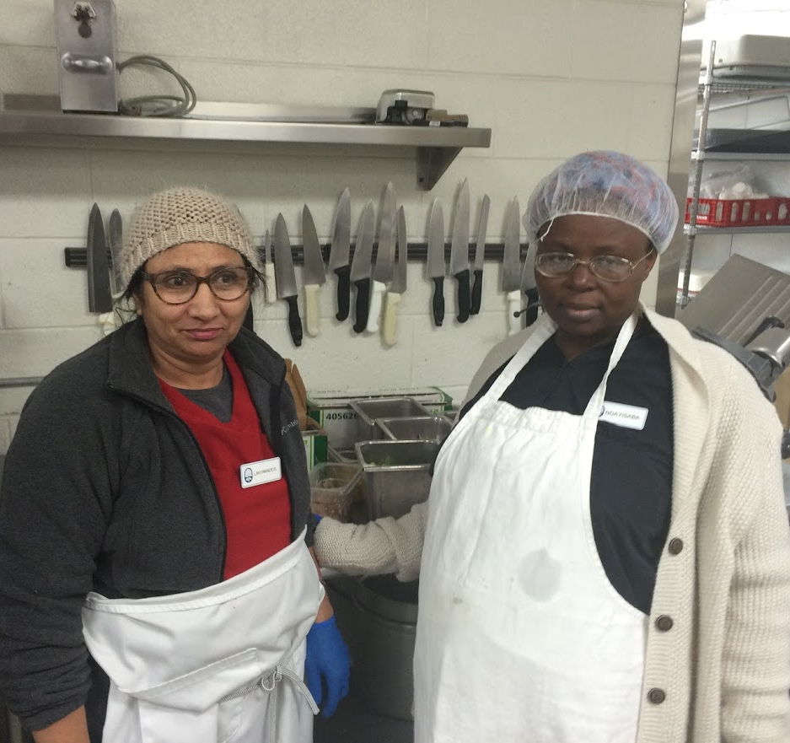
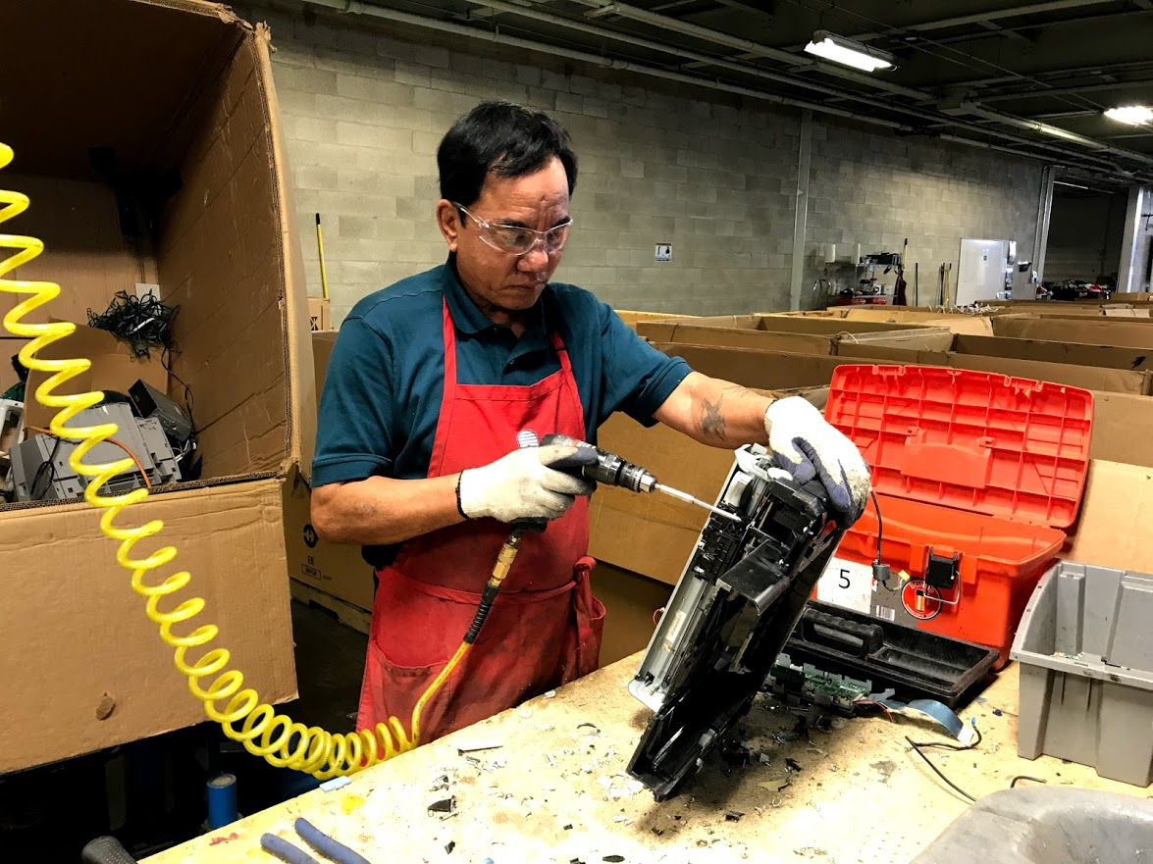
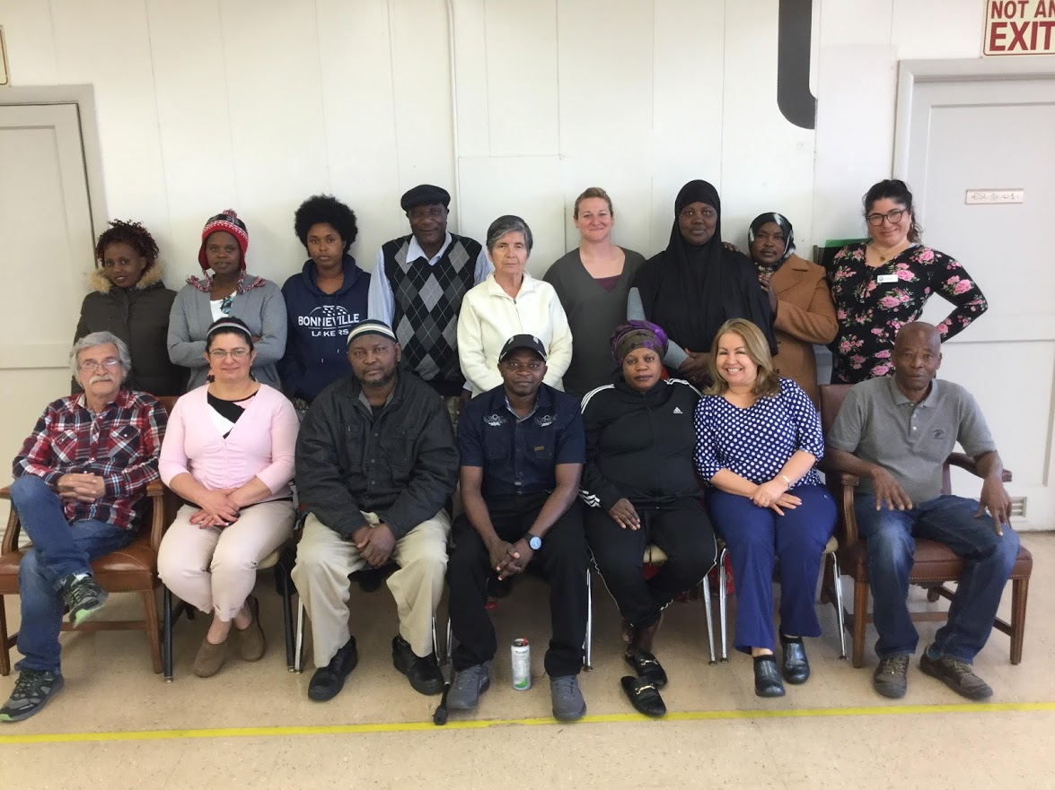
Humanitarian Center English Program
Partnership: Granite SD, LDS Church, DWS RSO
4 hours work + 4 hours English class = 8 hours pay
Work training & job placement
150 students, open enrollment, up to one year
Most students have limited formal education
6 levels

Slide 4
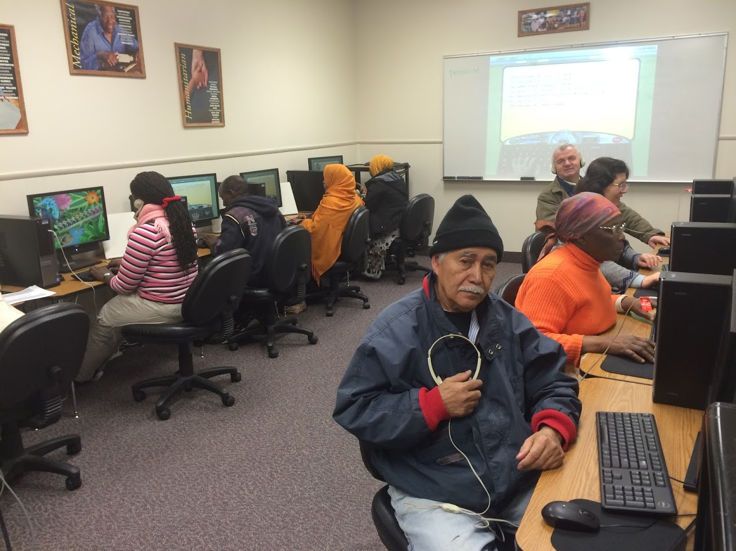
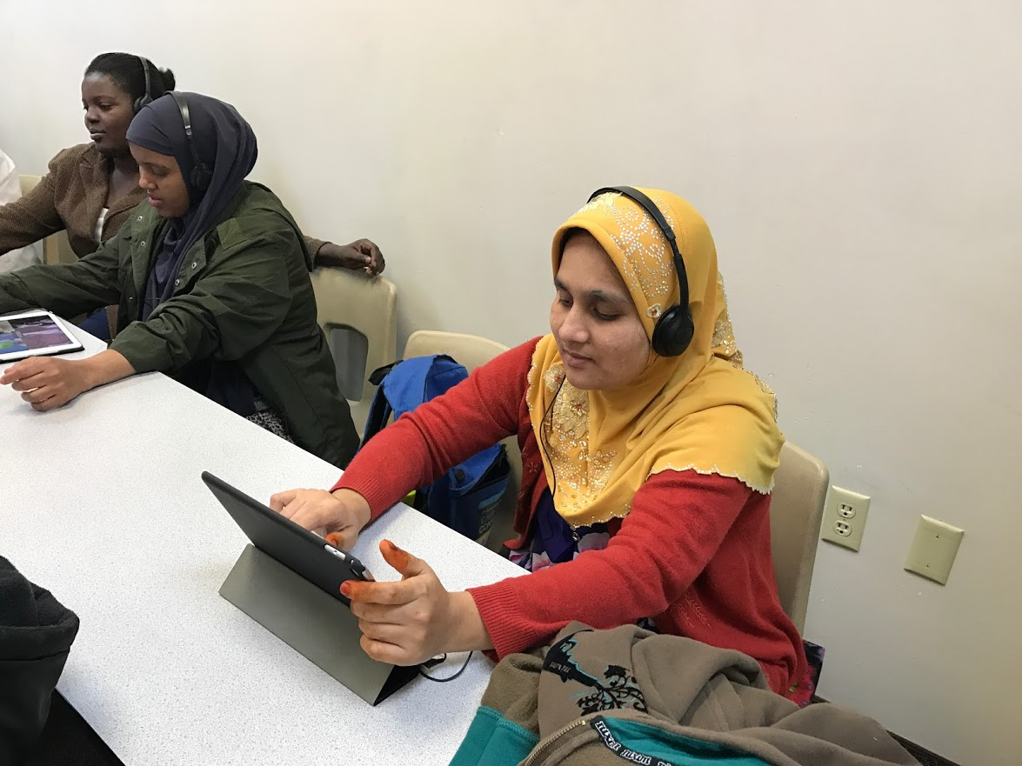
Technology at HC
Computer Lab
Classroom Projectors
iPads
Chromebooks
SMART Board

Slide 5
Chromebook Activities
Overview of class website:
eslcomputerlab.weebly.com
Outline of activity descriptions
Beginning Level Activities
Intermediate Level Activities

Slide 7
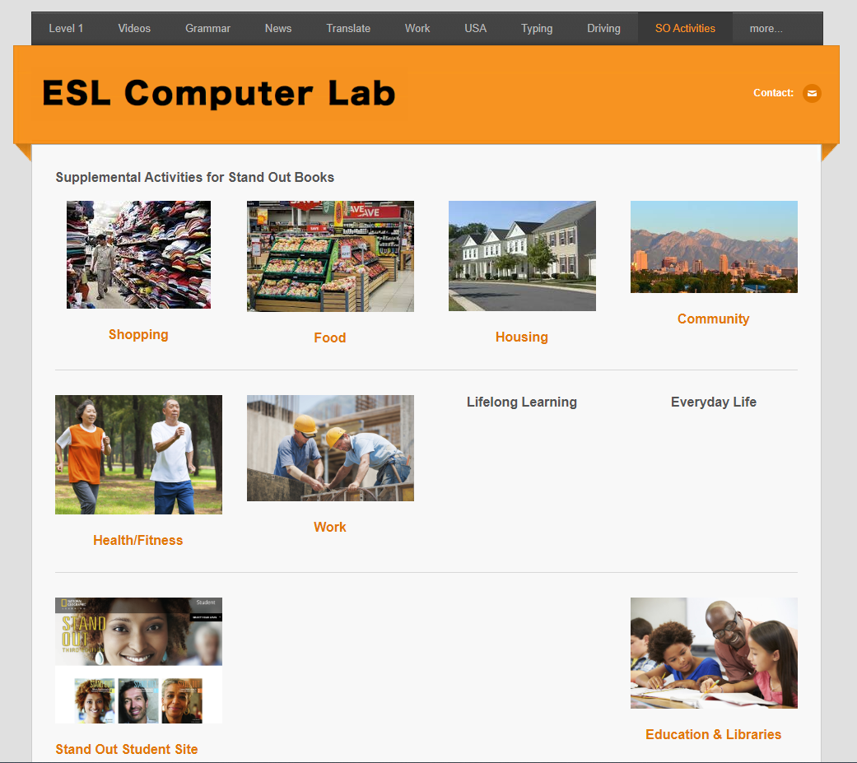

Slide 10
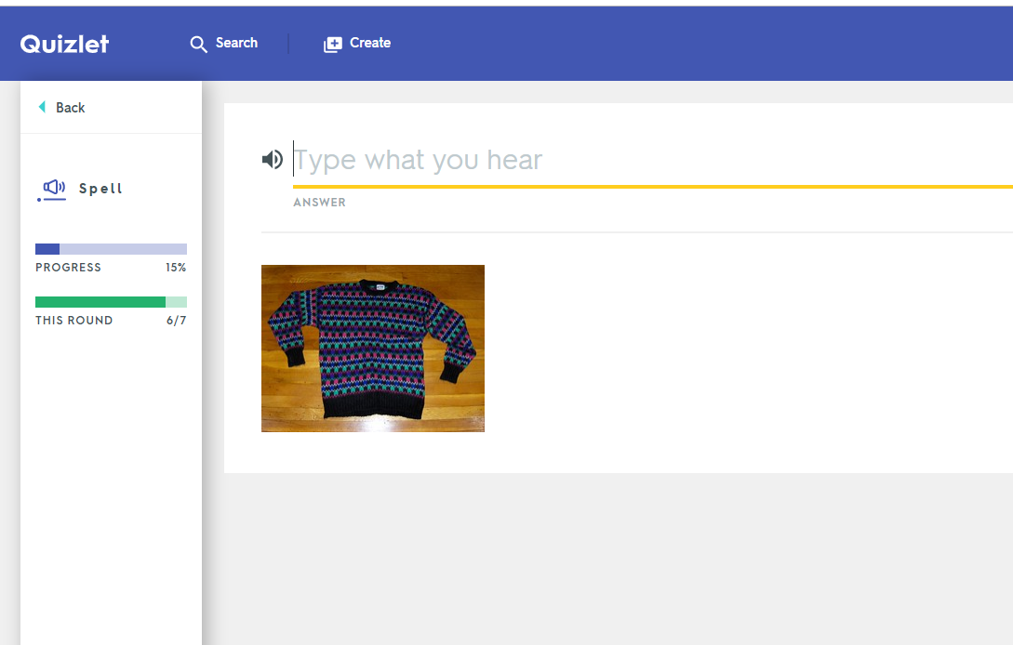

Slide 11
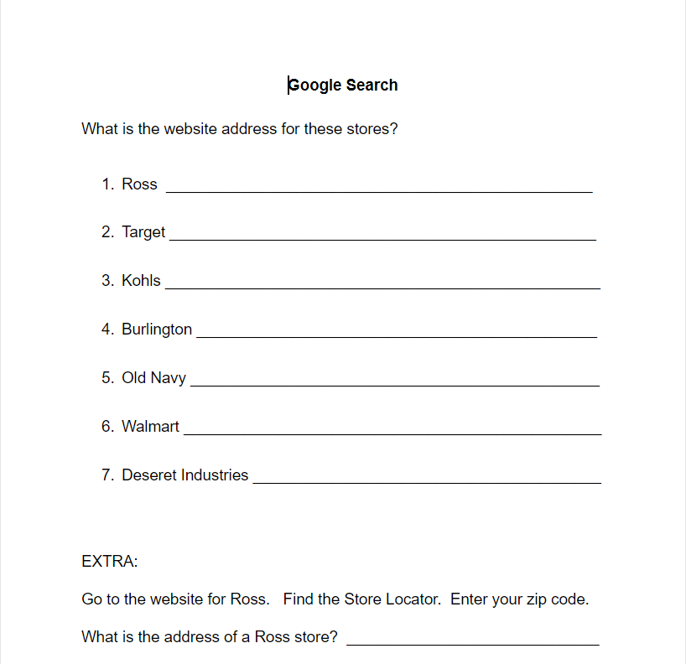

Slide 12
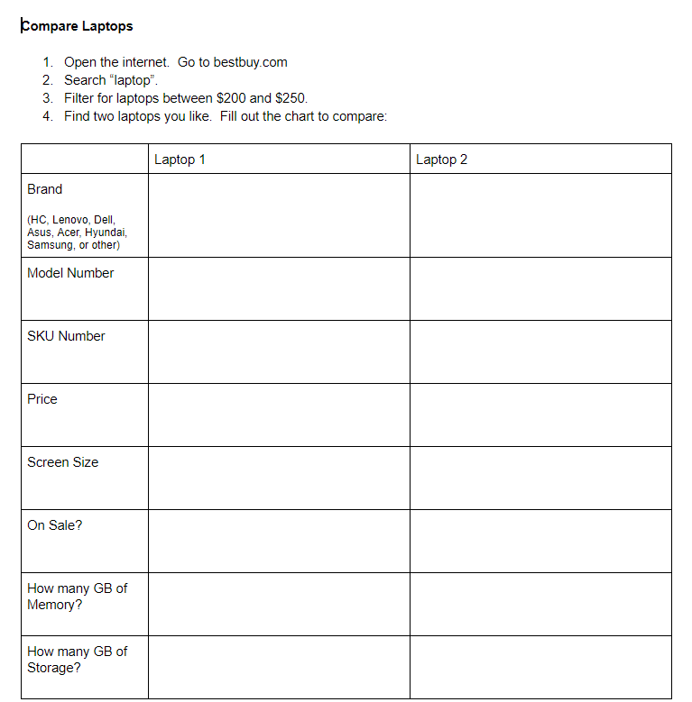

Slide 13
Tips for Teaching
Be prepared
Use generic logins & passwords
Class website
Demonstrate 3 times, then students can open computers

Slide 14
Benefits & Challenges

Slide 15
Questions

